Slide 1
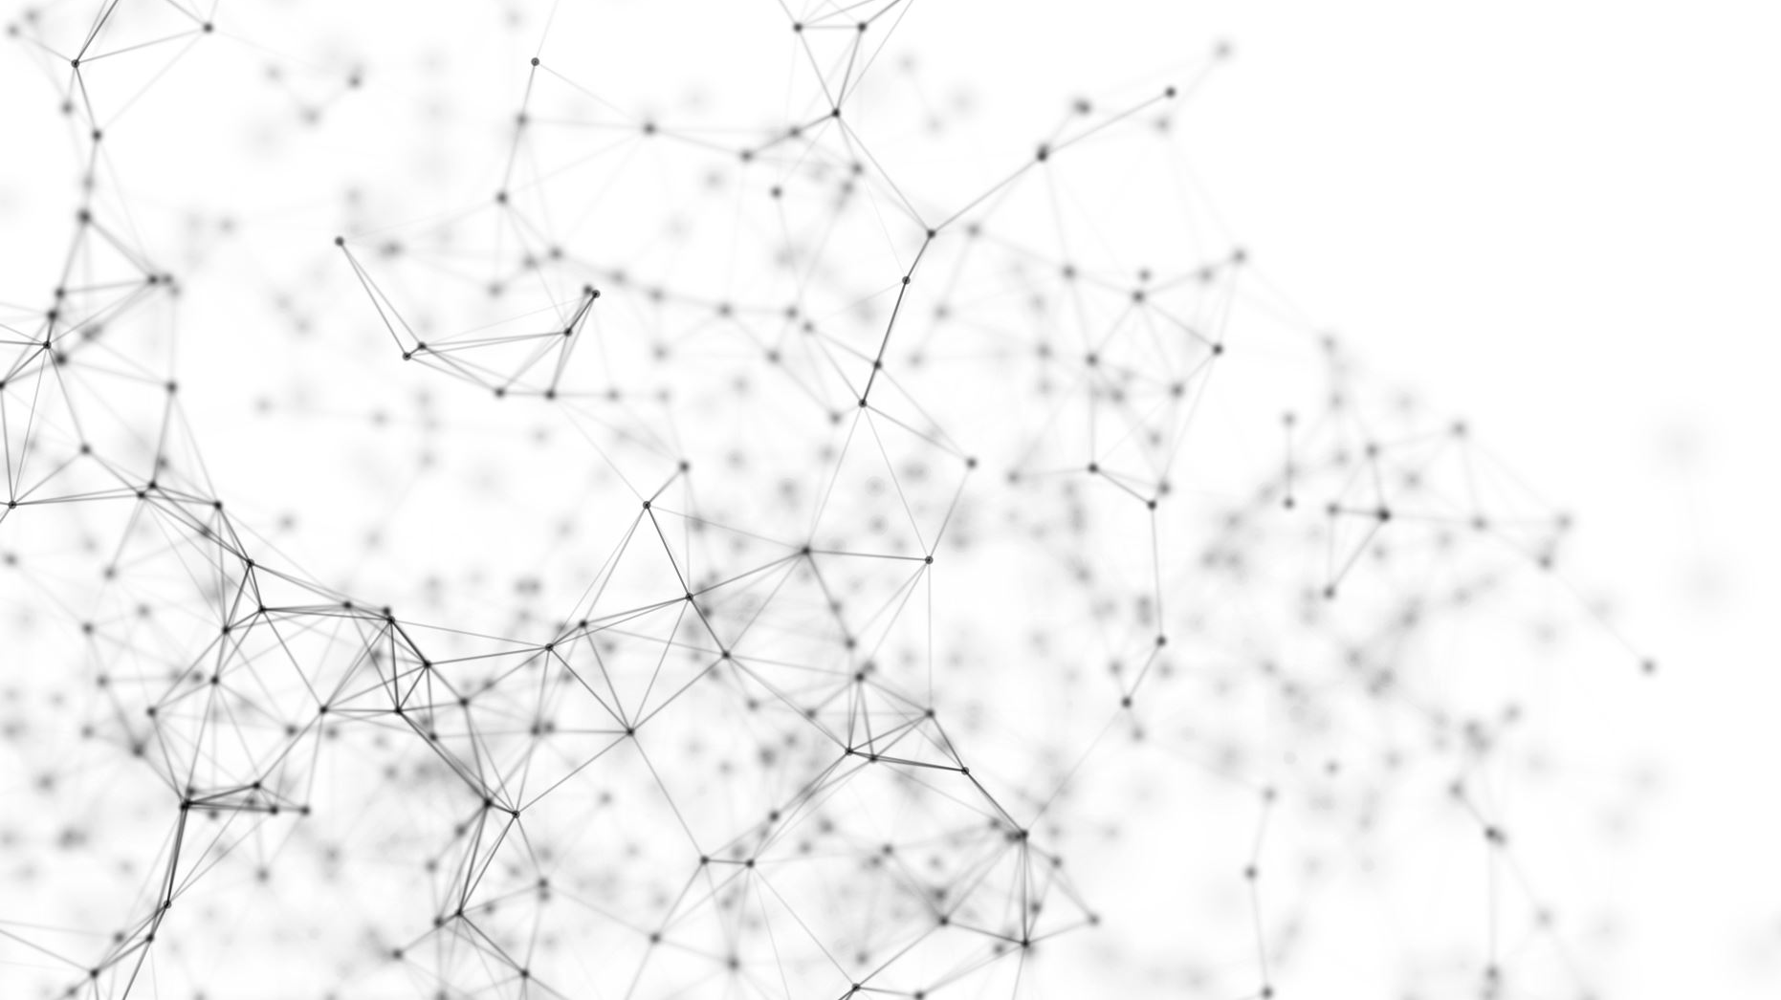
Semantic image segmentation implementing u-net++
Philipp Kochański
Katarzyna Policht
23.03.2024

Slide 2
Agenda
Image Segmentation
U-Net vs U-Net++
Project Overview
Dataset & Model structure
Training & Hyper parameter search
Model results
Live Presentation
Problems & improvement ideas

Slide 3
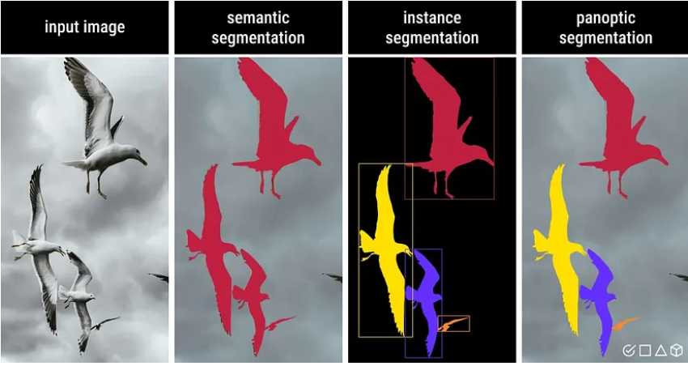
Image Segmentation
Image segmentation is a computer vision technique that assigns a label to every pixel in an image such that pixels with the same label share certain characteristics.
Source: https://medium.com/@raj.pulapakura/image-segmentation-a-beginners-guide-0ede91052db7
Semantic Segmentation
Instance segmentation
Panoptic segmentation
Classifies each pixel based on its semantic class. All the birds belong to the same class.
Assigns unique labels to different instances, even if they are of the same semantic class
Combines semantic and instance segmentation, providing both class-level and instance-level labels.

Slide 4
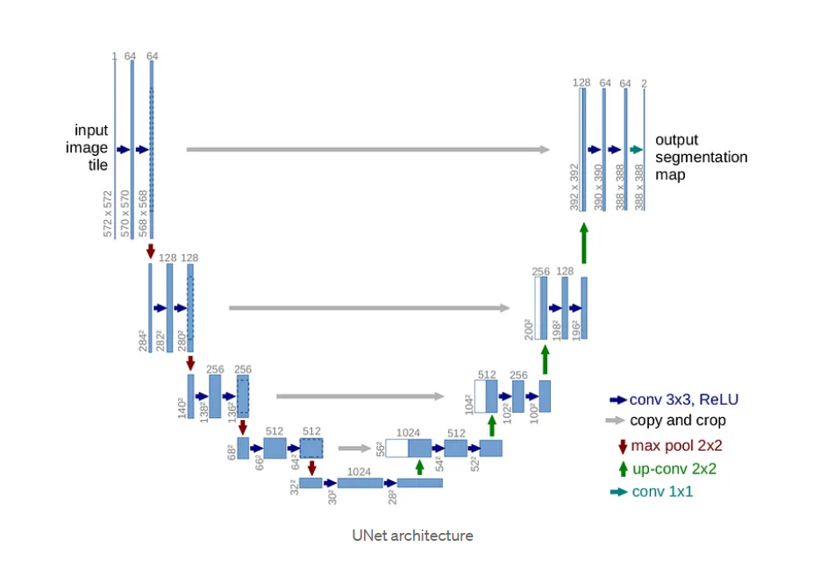
U-Net
Neural network architecture designed for image segmentation (medical images)
Symmetric structure resembling the letter „U“
Consists of:
Encoder Path
Blocks with 2 Convolutions and ReLU Activations
Max Pooling
Decoder Path
Blocks
Deconvolution
Skip Connections
Source: https://lmb.informatik.uni-freiburg.de/people/ronneber/u-net/

Slide 5
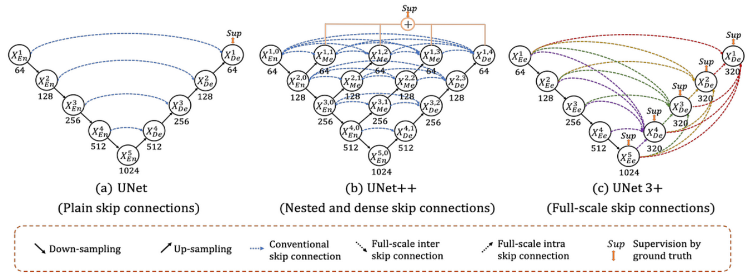
U-Net++
Improved U-Net architecture
Nested & Dense skip connections
Captures multi-scale contextual information
Better accuracy due to feature merging at different scale levels
Deep Supervision
Outputs at different learning stages are used in/for the loss function
Source: https://sh-tsang.medium.com/reading-unet-3-a-full-scale-connected-unet-medical-image-segmentation-ebb5e7f53caa

Slide 6
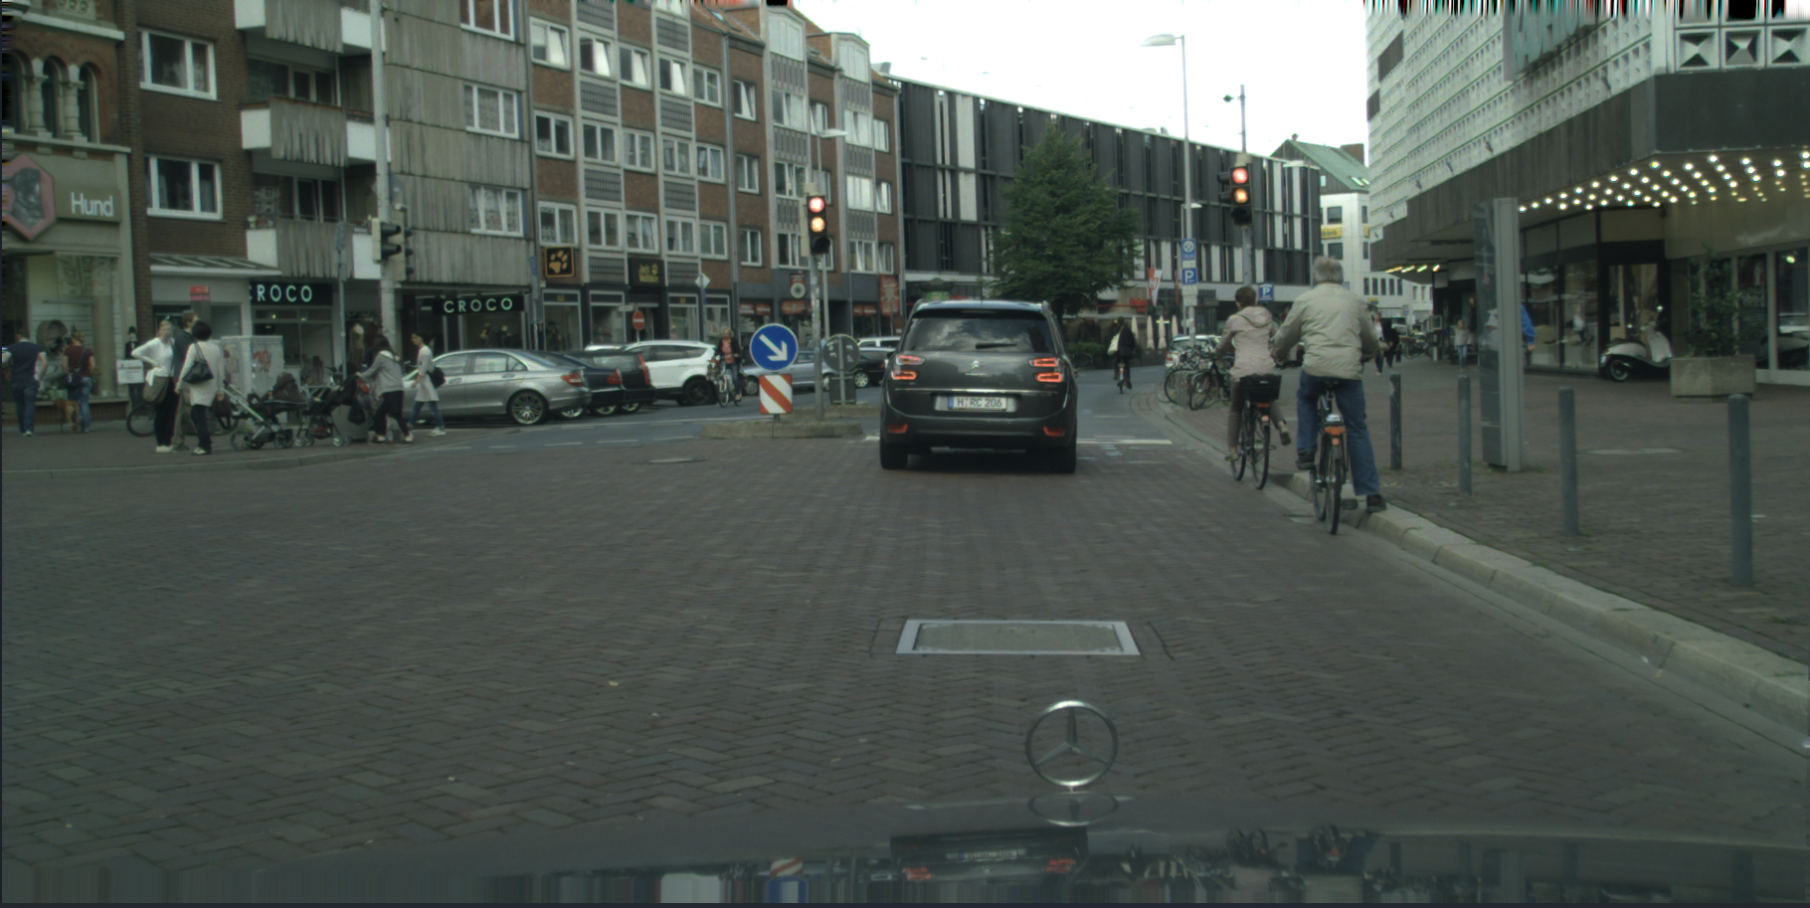
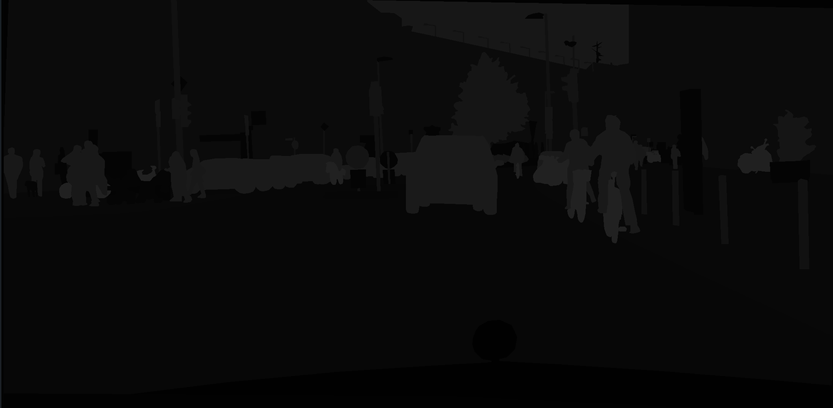
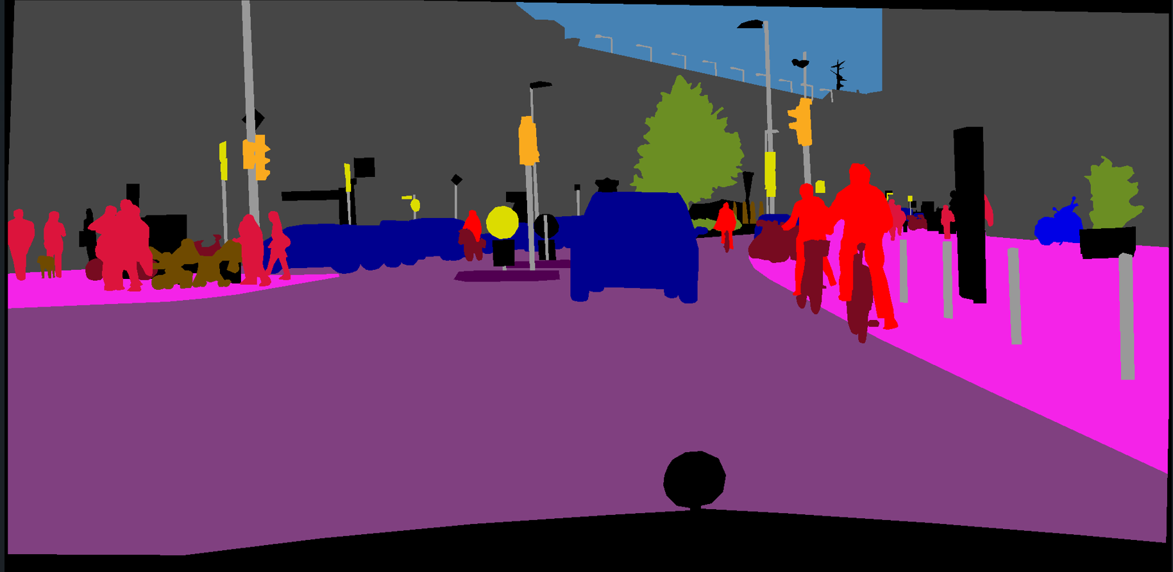
Project Overview - Dataset
Cityscapes Dataset
The Cityscapes dataset focuses on semantic understanding of urban street scenes
Features
Complexity: 30 classes
Diversity :
50 cities
Good/medium weather conditions
Several months (spring, summer, fall)
Volumen:
5 000 annotated images (fine annotation)
Source: https://www.cityscapes-dataset.com/

Slide 7
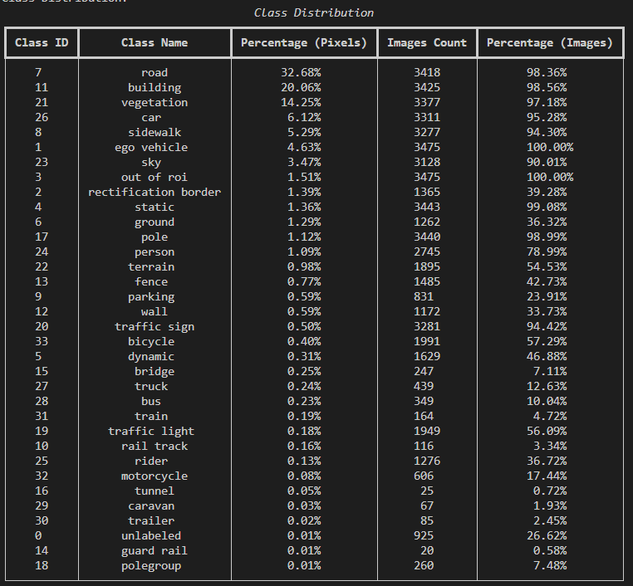
Project Overview - Dataset
Class Definitions
Class Distribution (3475 images/masks)
Flat: road, sidewalk, parking, rail track
Human: person, rider
Vehicle: car, truck, bus, on rails, motorcycle, bicycle, caravan, trailer
Construction: building, wall, fence, guard rail, bridge, tunnel
Object: pole, pole group, traffic sign, traffic light
Nature: vegetation, terrain
Sky: sky
Void: ground, dynamic, static

Slide 8
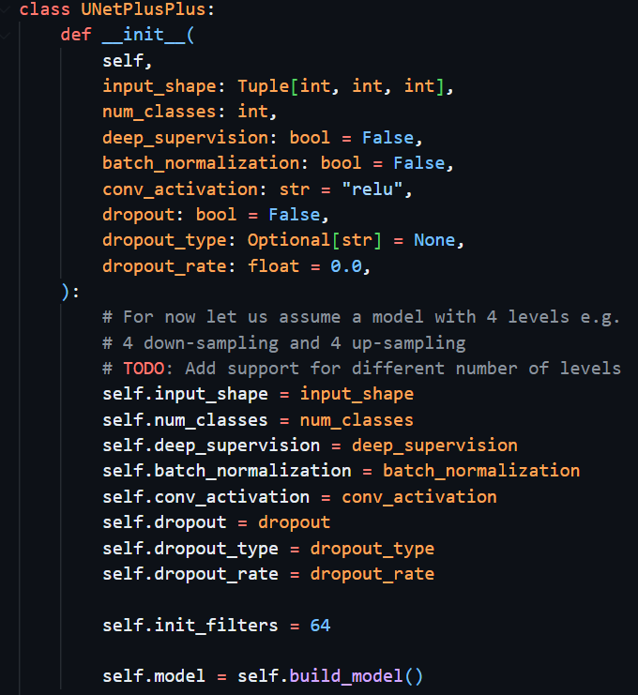
Project Overview – Model structure
Implemented a U-Net++ model (UNetPlusPlus Python class) as outlined in the original U-Net and U-Net++ papers
Depth: 4 levels
Initial Filters: 64
Modifications
Batch normalization
Dropout
Simple e.g. dropping single neurons
Spatial e.g. dropping entire feature maps
Convolution with same padding
Uses a custom batch data generator
Uses binary masks
Project URL: https://github.com/Korred/unet-pp

Slide 9
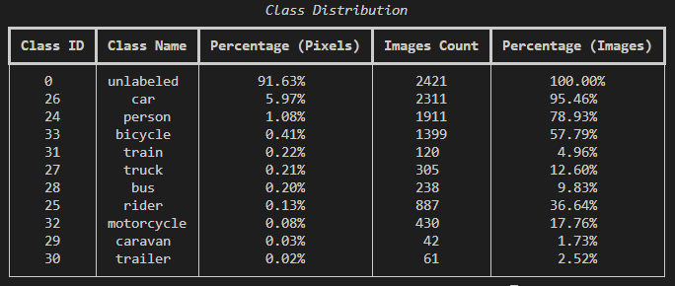
Project Overview – Training & Hyperparameters
Training
Classes: 10
Image size: 512x256 [original 2048x1024]
Batch size: 4 [606 batches/epoch]
Loss function: Categorical Cross Entropy
Hardware: GeForce RTX 4080 SUPER
Training time: 78 min (26 epochs)
Params to learn: 36.173.195
Hyperparameter Tuning
Tuner: Keras Tuner
Algorithm: Hyperband
Elapsed time: ~7 days
Hyperparameters:
Deep Supervision [True, False]
Batch Normalization [True, False]
Activation [ReLU, Leaky ReLU, ELU]
Optimizer [Adam, Adamax, SGD]
Learning rate [0.01, 0.001, 0.0001]
Dropout [True, False]
Type [simple, spatial]
Rate [0.1, 0.2, 0.5]

Slide 10
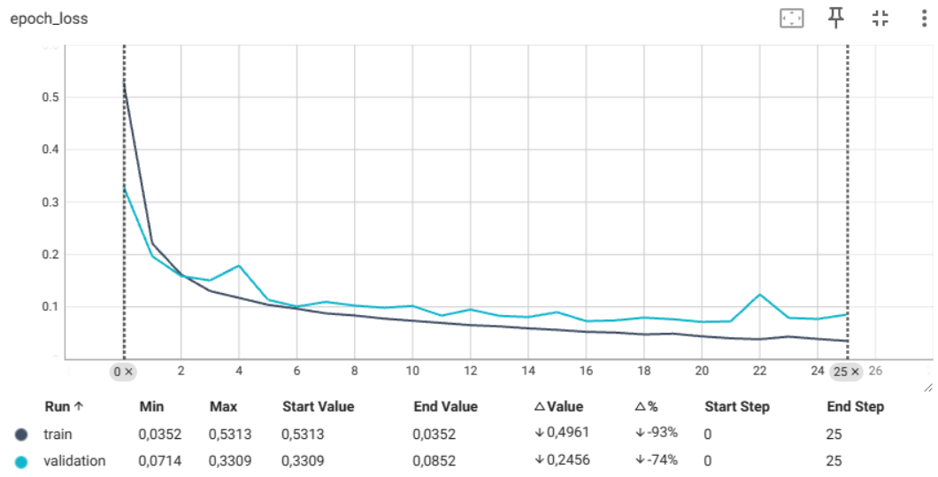
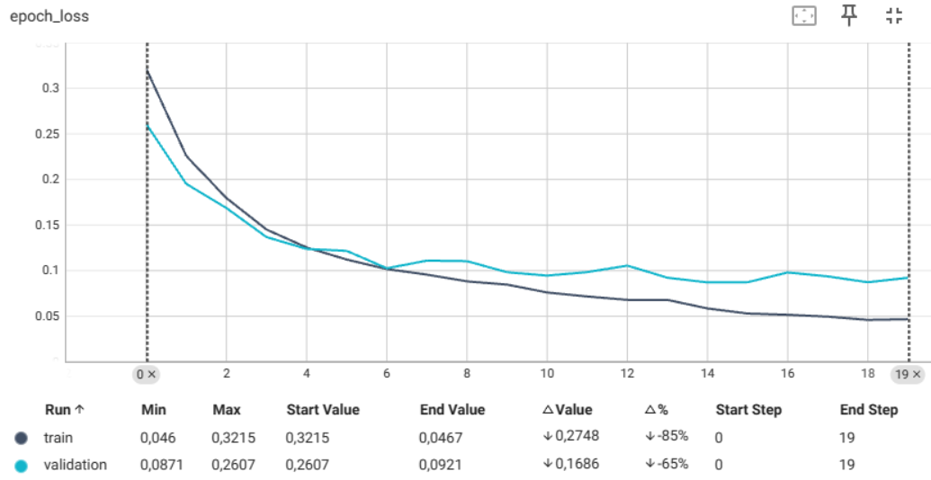
Model results
Hyperparameter | Best Model | Default Model
Deep Supervision | False | False
Batch Normalization | True | False
Activation | ReLU | ReLU
Optimizer | Adam (0.0001) | Adam (0.001)
Dropout | False | False
Validation loss | 0,0714 | 0,0871
Test loss | 0,0662 | 0,0799
Training time | 78 min (26 epochs) | 52 min (20 epochs)
Learning curve

Slide 11

Live Presentation
SWITCH TO VS CODE

Slide 12
Problems & Improvement ideas
Problems
Improvement Ideas
Resource limitations e.g. GPU memory
Reduced batch size (generalization)
Reduced image size (information loss)
Dying ReLU
Image augmentation
Training models on small patches rather than full / resized images
Batch sizes 8 – 32
Additional loss functions such as Focal loss
Add or reduce levels in model
Change initial number of filters

